Slide 1
SPRINT -1

Slide 2

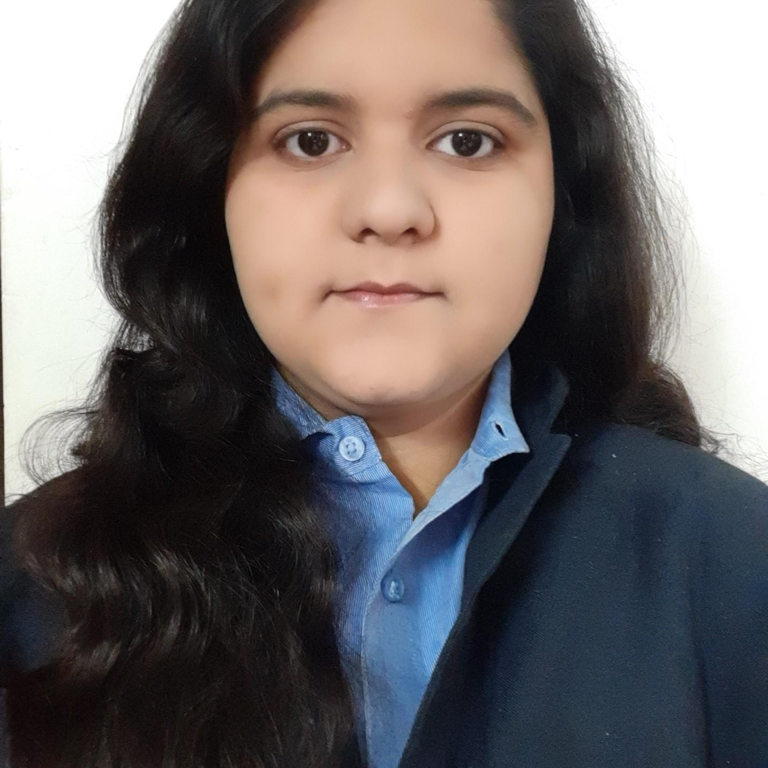
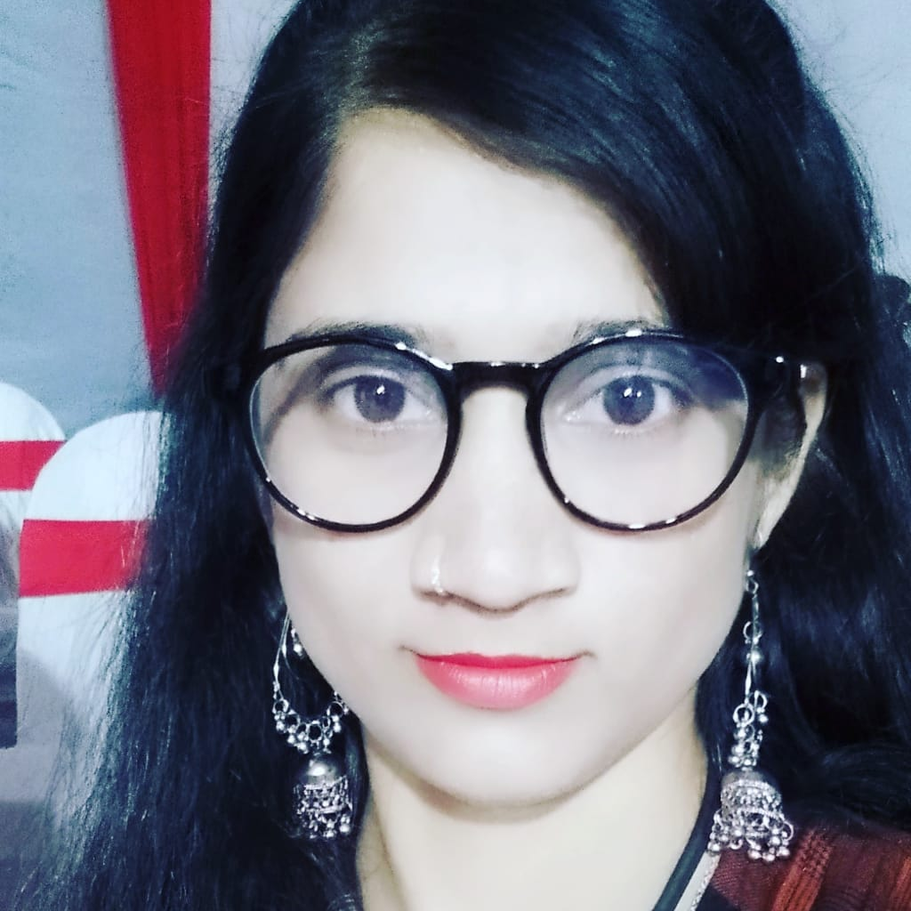
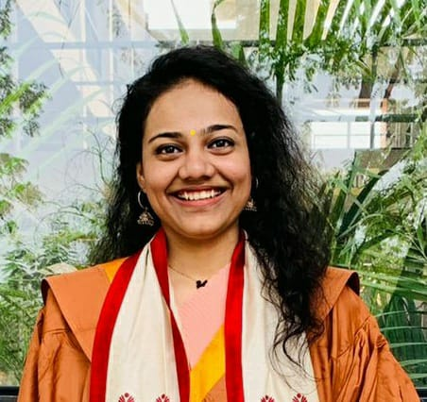


Team Presentation
Divya Pednekar
Alisha
Shaikh
Ashwini
Thigale
Ashwini
Yadav
Anuradha
Gudipati

Slide 3
CONTENTS
About the Project
Role of testers in each Module
Process of Testing
Timeline
Functionalities
Epics and User Stories
Test Scenario
Test Cases
Defect Reporting
Traceability Matrix
Test summary Report
Challenges faced and overcome

Slide 4
ABOUT THE PROJECT
Big Basket is one of the largest online grocery supermarket in India. With an aim to completely revolutionise the online marketplace and become people’s favourite
BigBasket allows you to order grocery products, fulfil daily needs products and even beauty products within a few clicks on your mobile device.
The Main Modules Tested for bigbasket are:
Verify Register Functionality
Verify Login Functionality
Verify Location Functionality
Verify Search Item Functionality
Verify Buy Item Functionality

Slide 5

Roles of Tester in each Module
MODULE | TESTER
Register Functionality | Ashwini Thigale
Login Functionality | Anuradha Gudipati
Location Functionality | Ashwini Yadav
Search Item Functionality | Divya Pednekar
Buy Item Functionality | Alisha Shaikh

Slide 6
Process of Testing
Writing Functionality
Writing Epics and user stories
Writing Test Scenario
Writing Test cases
Executing Test cases
Writing Defect Report
Writing Traceability Matrix
Writing Test Summary Report

Slide 7
Timeline
Dividation of modules
Studying and writing down the functionalities
Test case design and execution
Evaluation
DAY 1
DAY 2
DAY 3
DAY 4
DAY 5
Wrote epics and user stories for every module
Designed Traceability matrix

Slide 8
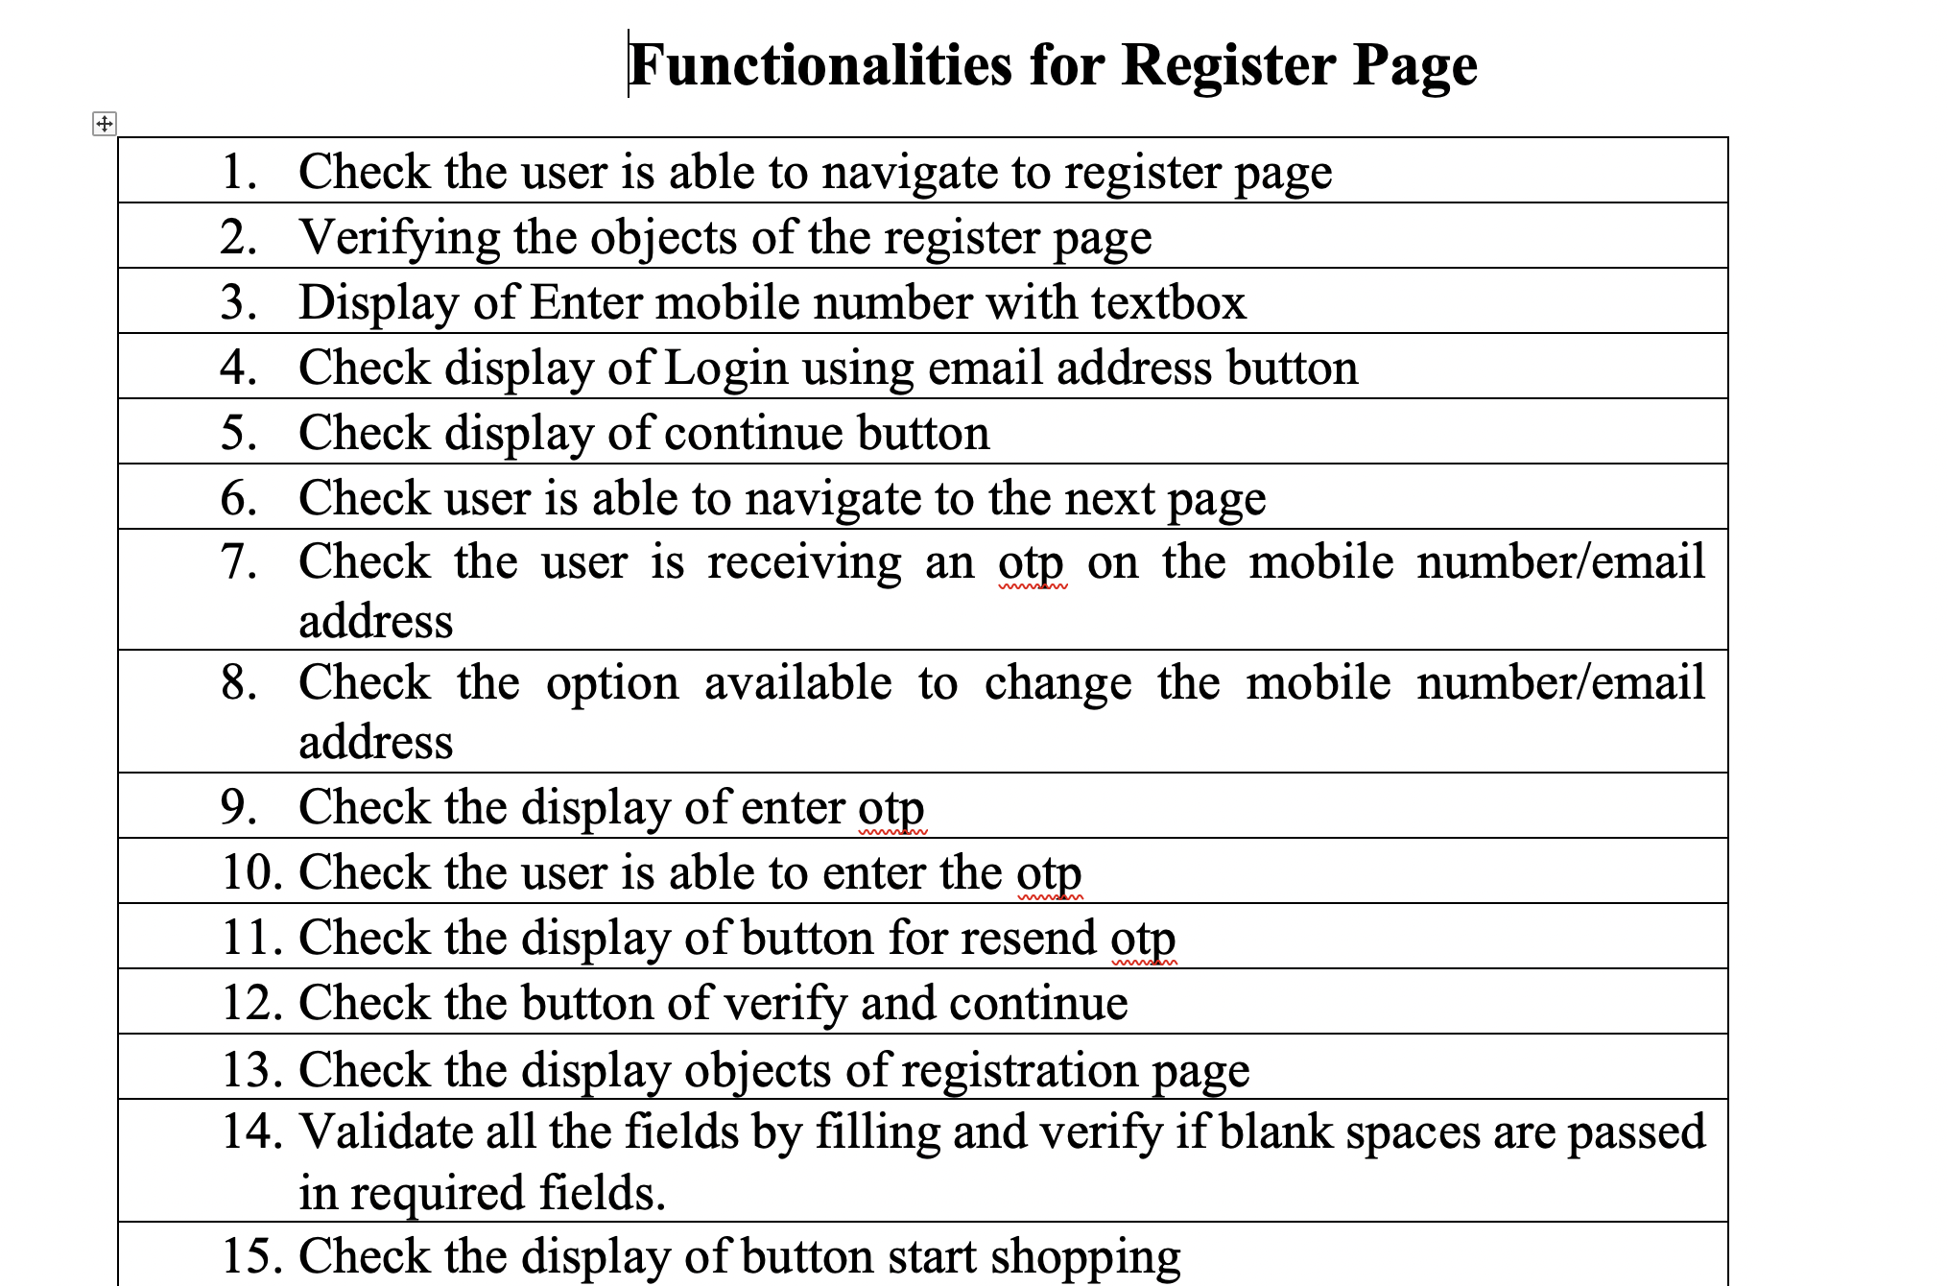
Functionalities

Slide 9
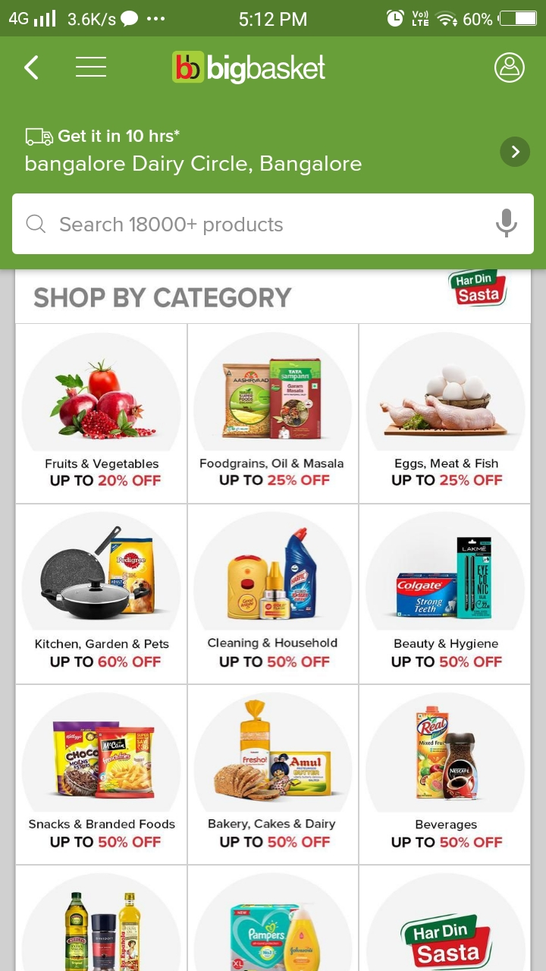
Epics And User Stories
Epic : also called “user stories,” are short requirements or requests written from the perspective of an end user.
User Stories : are short requirements or requests written from the perspective of an end user.

Slide 10
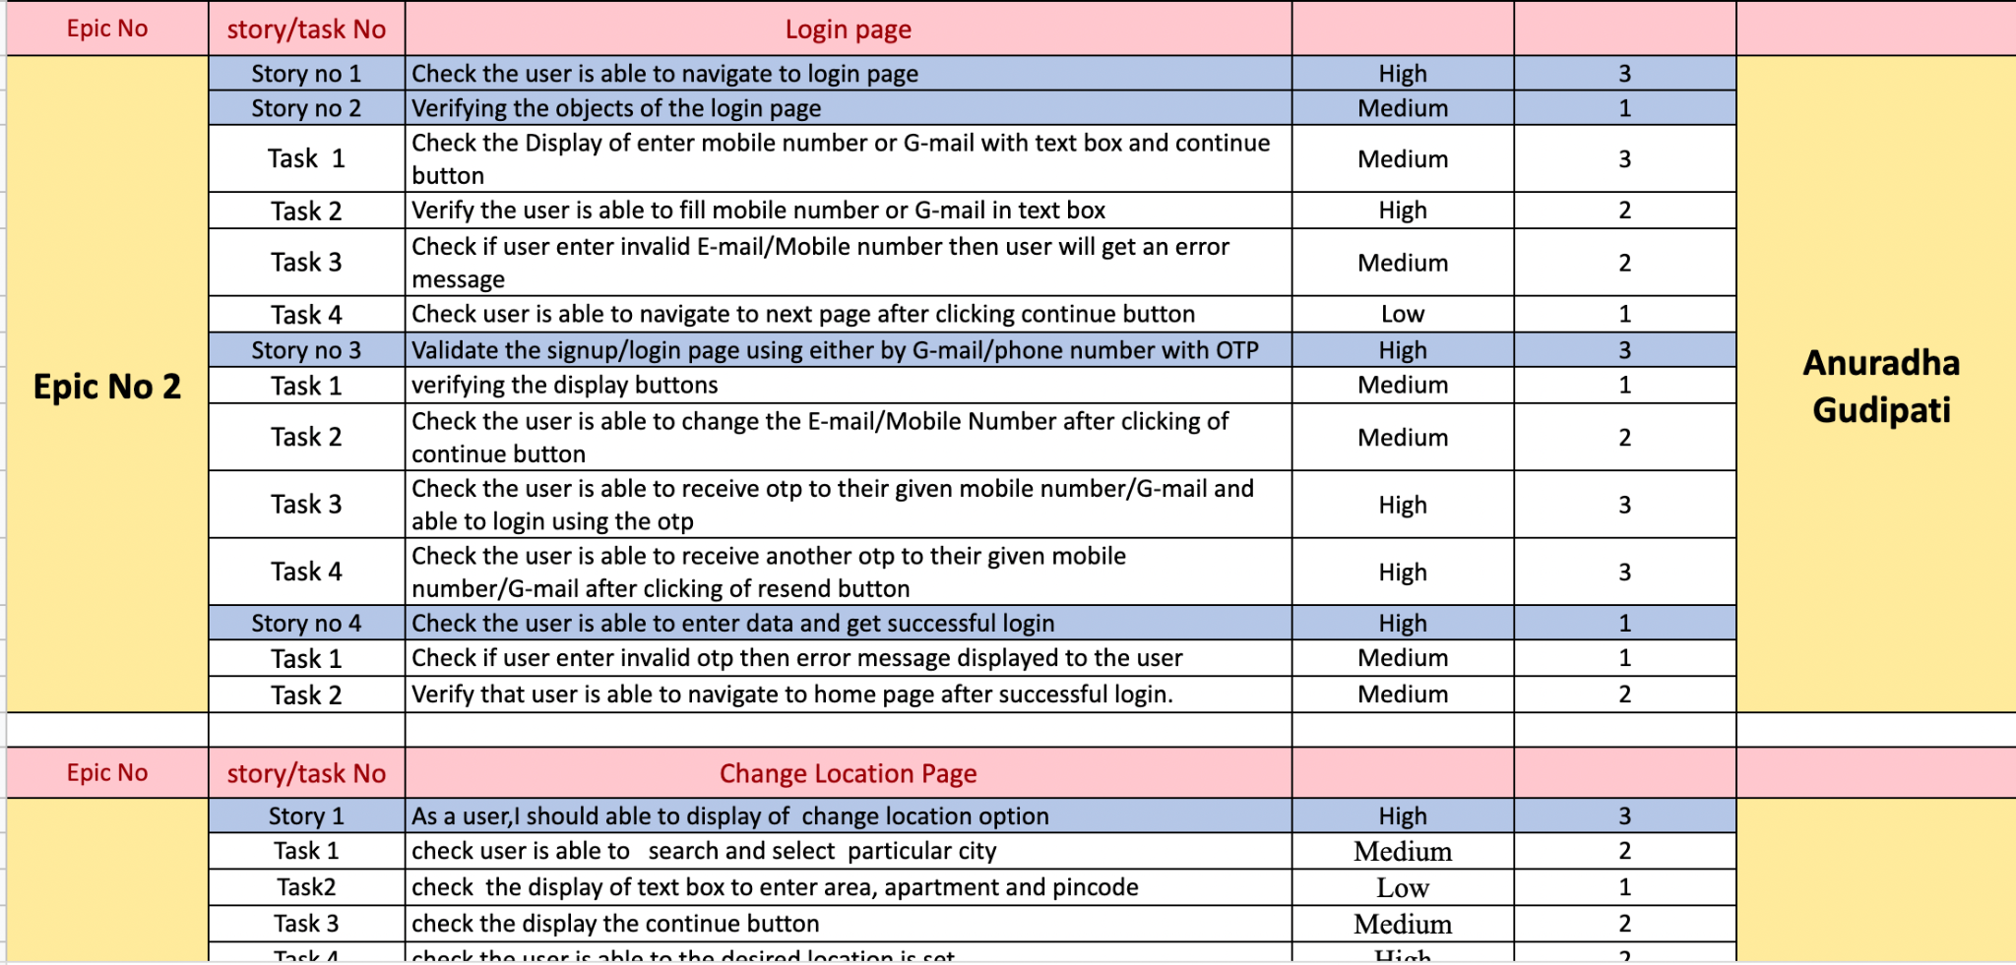

Slide 11
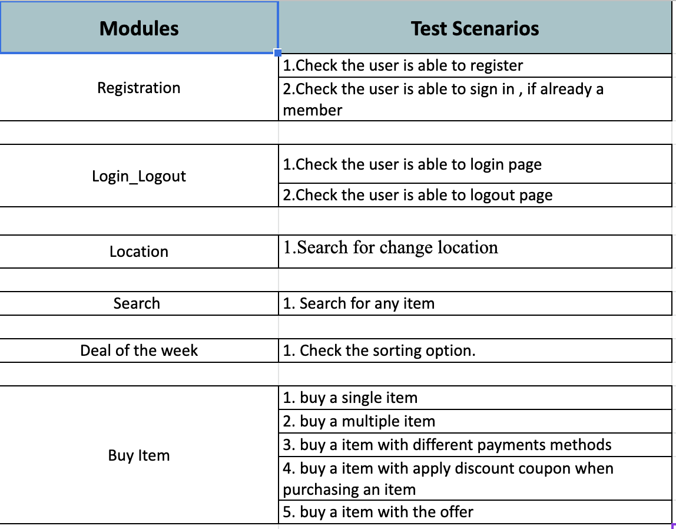

Test Scenario

Slide 12
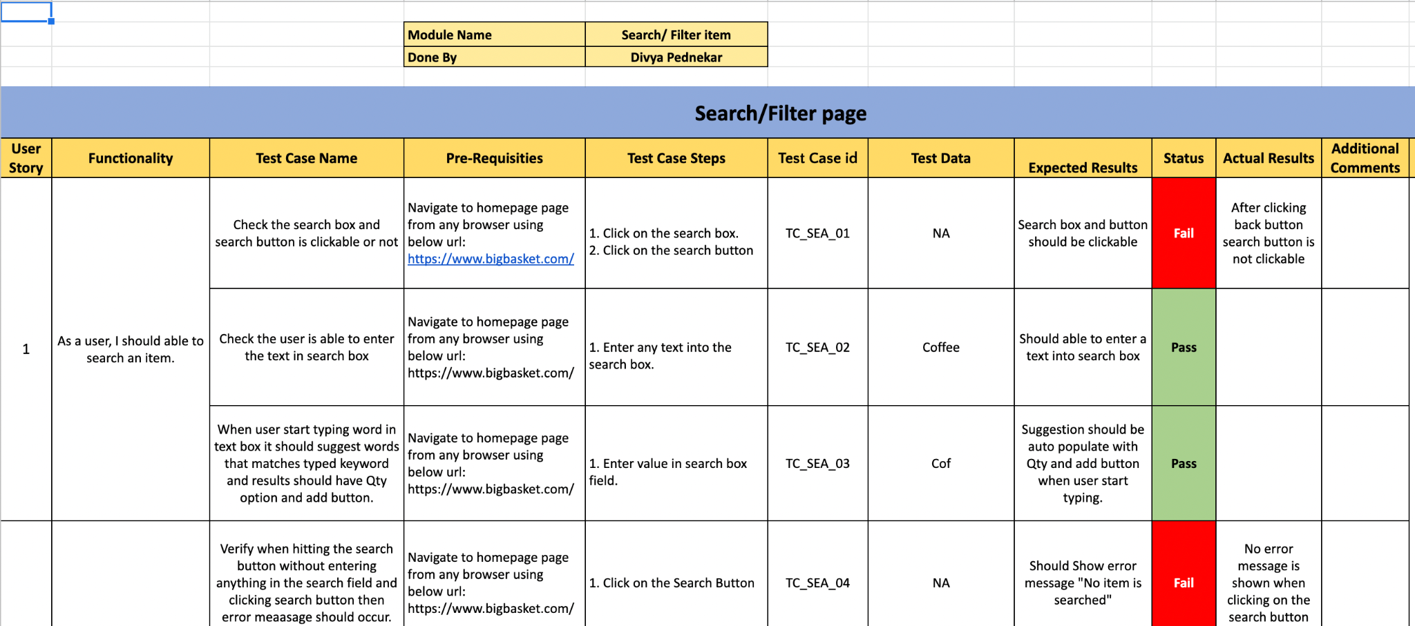

Test Cases

Slide 13
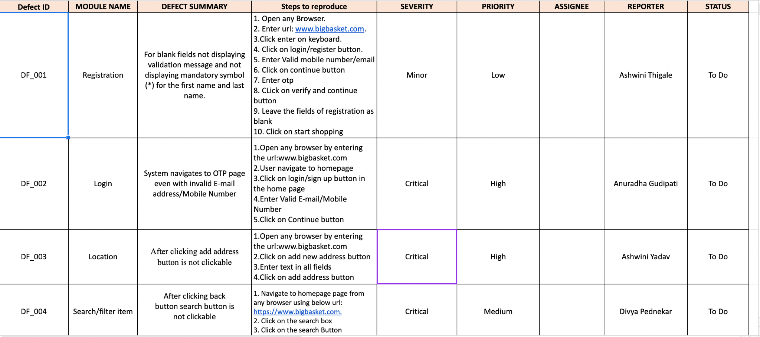

Defect Reporting

Slide 14
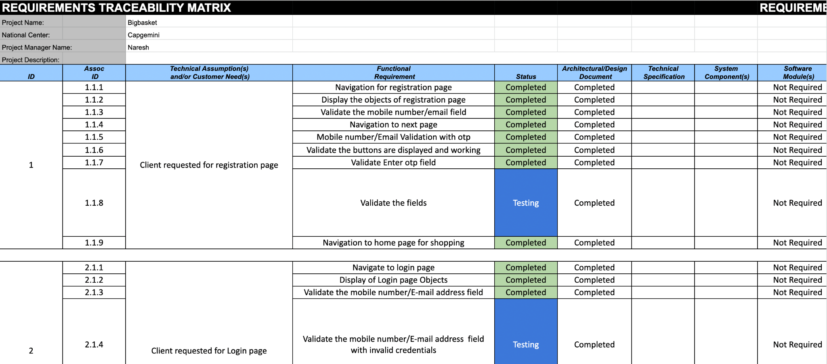

Traceability Matrix

Slide 15
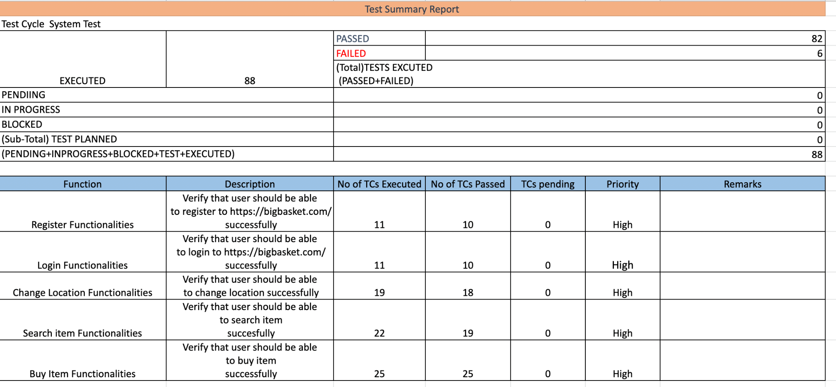

Test Summary Report

Slide 16
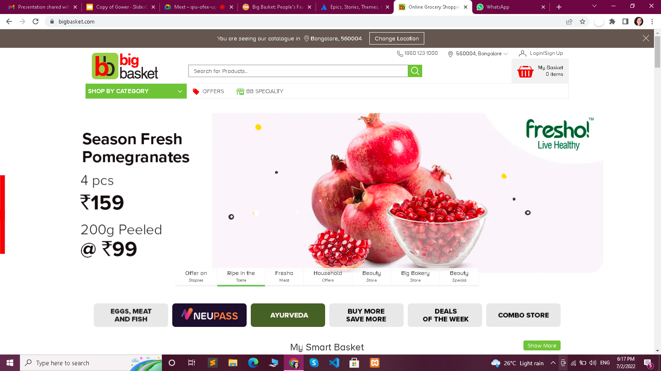
Challenges Faced
Testing the Complete Application
It is not possible to test each and every combination during testing.
Being the trainee, We missed many functionality in each epics. And faced difficulty at the start of writing test cases.
How did we Overcome this challenge
With the help of our trainer's guidelines and with some self study we were able to create proper Test case with every functionality possible.

Slide 17
Thanks!
Any questions?

